Slide 1
Database Systems
Lecture 3-Chapter # 8
Relational algebra
Alina Arshad
alina.arshad@nu.edu.pk

Slide 2
Some properties of JOIN
Consider the following JOIN operation:
R(A1, A2, . . ., An)
S(B1, B2, . . ., Bm)
R.Ai=S.Bj
Result is a relation Q with degree n + m attributes: Q(A1, A2, . . ., An, B1, B2, . . ., Bm), in that order.
The resulting relation state has one tuple for each combination of tuples—r from R and s from S, but only if they satisfy the join condition r[Ai]=s[Bj]
Hence, if R has n_{R} tuples, and S has n_{S} tuples, then the join result will generally have less than n_{R} * n_{S} tuples.
Only related tuples (based on the join condition)
will appear in the result

Slide 3
Some properties of JOIN
The general case of JOIN operation is called a Theta-join:
R theta S
The join condition is called theta
Most join conditions involve one or more equality conditions “AND” together; for example:
R.Ai=S.Bj AND R.Ak=S.Bl AND R.Ap=S.Bq
R.DeptID=S.DeptID AND S.Location=’Building A

Slide 4
Binary Relational Operations: EQUIJOIN
EQUIJOIN Operation:
The most common use of join involves join conditions with equality comparisons only
Such a join, where the only comparison operator used is =, is called an EQUIJOIN.
In the result of an EQUIJOIN we always have one or more pairs of attributes (whose names need not be identical) that have identical values in every tuple.
The JOIN seen in the previous example was an EQUIJOIN.

Slide 5
Binary Relational Operations: NATURAL JOIN Operation
NATURAL JOIN Operation
Another variation of JOIN called NATURAL JOIN denoted by * was created to get rid of the second (superfluous) attribute in an EQUIJOIN condition.
because one of each pair of attributes with identical values is superfluous
The standard definition of natural join requires that the two join attributes, or each pair of corresponding join attributes, have the same name in both relations
If this is not the case, a renaming operation is applied first.

Slide 6
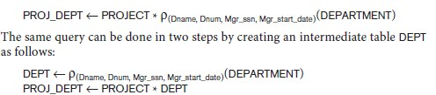
Binary Relational Operations: NATURAL JOIN (continued)
Example: To apply a natural join on the DNUMBER attributes of DEPARTMENT and DEPT_LOCATIONS, it is sufficient to write:
DEPT_LOCS ← DEPARTMENT * DEPT_LOCATIONS
Only attribute with the same name is DNUMBER
An implicit join condition is created based on this attribute: DEPARTMENT.DNUMBER=DEPT_LOCATIONS.DNUMBER
Another example: Q ← R(A,B,C,D) * S(C,D,E)
The implicit join condition includes each pair of attributes with the same name, “AND”ed together:
R.C=S.C AND R.D.S.D
Result keeps only one attribute of each such pair:
Q(A,B,C,D,E)
•

Slide 7
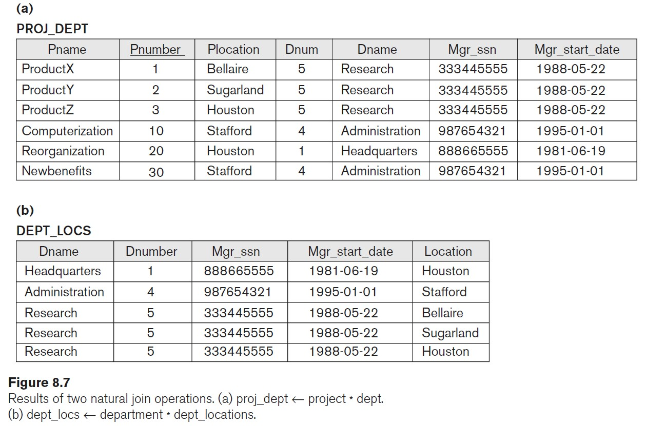
Example of NATURAL JOIN operation

Slide 8
N-Way Join
For example, consider the following three-way join:

Slide 9
Complete Set of Relational Operations
The set of operations including SELECT σ, PROJECT π , UNION 𝖴, DIFFERENCE − , RENAME ρ, and CARTESIAN PRODUCT X is called a complete set because any other relational algebra expression can be expressed by a combination of these five operations.
For example:
R ∩ S = (R 𝖴 S ) – ((R − S) 𝖴 (S − R))
R <join condition>^{S = σ} <join condition> ^{(R X S)}

Slide 10
R (Students taking Database course)
S (Students taking AI course)
ID | Name
1 | Alice
2 | Bob
3 | Carol
ID | Name
4 | David
2 | Bob
3 | Carol
R ∩ S = (R 𝖴 S ) – ((R − S) 𝖴 (S − R)) prove?

Slide 11
R (Employees):
S (Departments):
EmpID | EmpName
1 | Alice
2 | Bob
DeptID | DeptName | EmpID
10 | HR | 1
20 | IT | 2
R <join condition> ^{S = σ} <join condition> ^{(R X S)}
^{Prove?}

